Slide 1

Koala Inventory Management System

Slide 2
Introduction
This inventory management system simplifies tracking inventory, orders, and deliveries with real-time stock updates and automated alerts, supporting multi-location and system integration.

Slide 3
Objectives
Stockouts and Overstocks
Inefficiency
Poor Visibility
Time-Consuming Reporting

Slide 4
Target Audience
The primary users of this system are warehouse operators who need to efficiently manage inventory across various locations.

Slide 5
Brief
An Inventory Management System (IMS) streamlines tracking of stock, orders, and deliveries with real-time updates and automated alerts. It supports multi-location management and integrates with systems like accounting and supply chain. Built-in authentication and authorization ensure secure access, allowing only authorized users to manage inventory and operations.

Slide 6
Technology stack
ASP.NET MVC
SQL SERVER
AJAX for asynchronous communication
jQuery for enhancing the user interface.

Slide 7
System Architecture

Slide 8
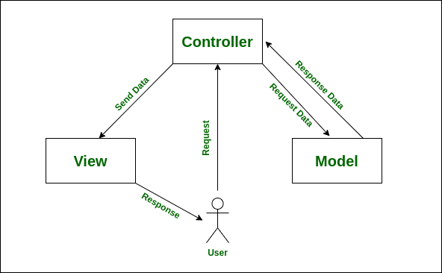
MVC Architecture
Disadvantages of Using a Normal MVC Project Structure:
• Tightly Coupled Code
• Limited Scalability
• Difficulty in Unit Testing
• Poor Reusability
• Inflexibility in Data Access Layer
• Violated SOLID Principles

Slide 9
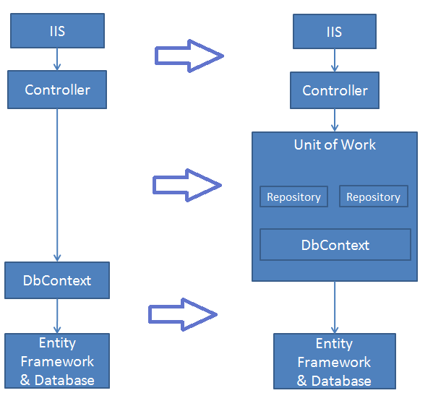

Solution: repository pattern
Advantages:
• abstracts the data access
• separates data access from business logic
• supports dependency injection
• flexibility in changing data source
• 3 layers

Slide 10
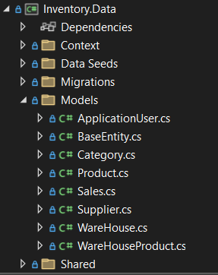
Data Layer
Includes:
• Database Context
• Migrations
• Models
• Data Seeds

Slide 11
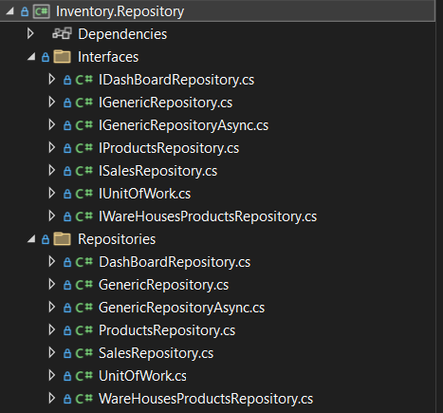
Repository Layer
Includes:
• Interfaces
• Repositories

Slide 12
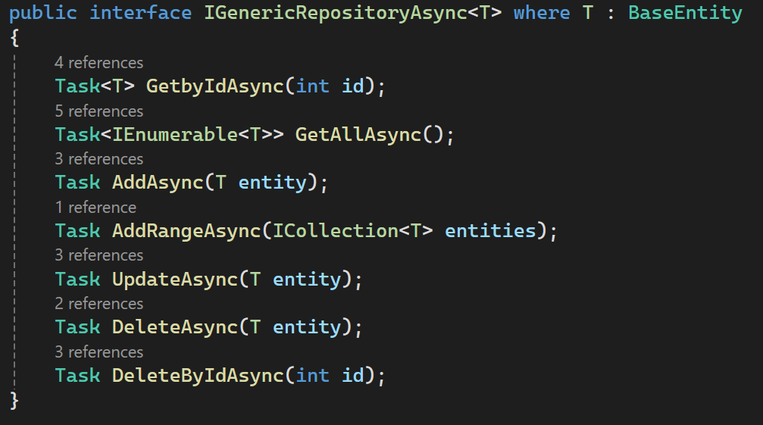
Generic repository
Includes:
• Centralized Logic
• Basic CRUD operations

Slide 13
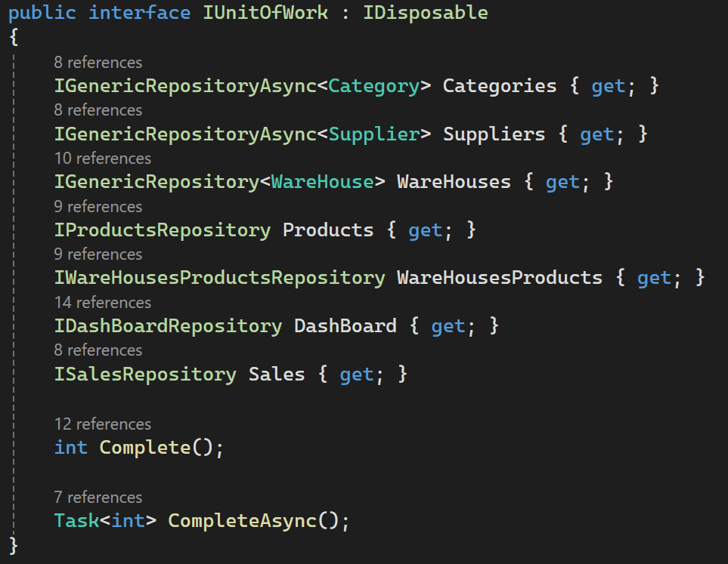
UNIt of work
Includes:
• All Repositories
• Complete method which saves
changes

Slide 14
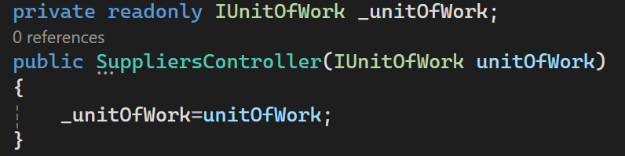
Using UNIt of work
Steps:
1- Register the unit of work as a service
2- Use Dependency injection to inject
the unit of work
3- Use the methods inside

Slide 15
Database Design

Slide 16
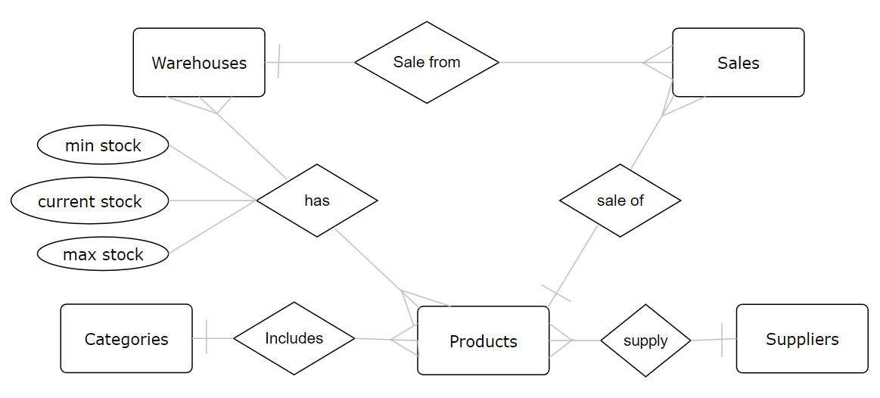
ER diagram simplified

Slide 17
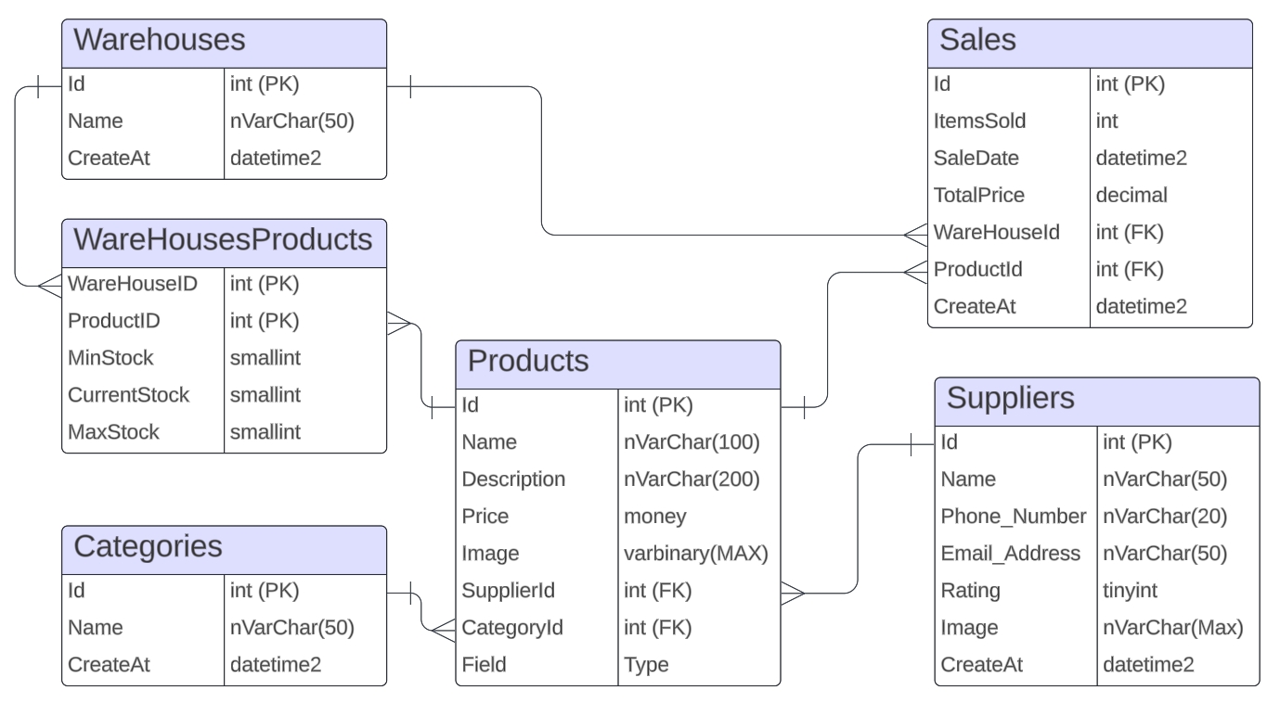
mapping

Slide 18
Dashboard

Slide 19
Dashboard BoldPoints
Full Statistics of warehouses, Products and stock
Each warehouse statistics
Low stock taple
Average sock category chart

Slide 20
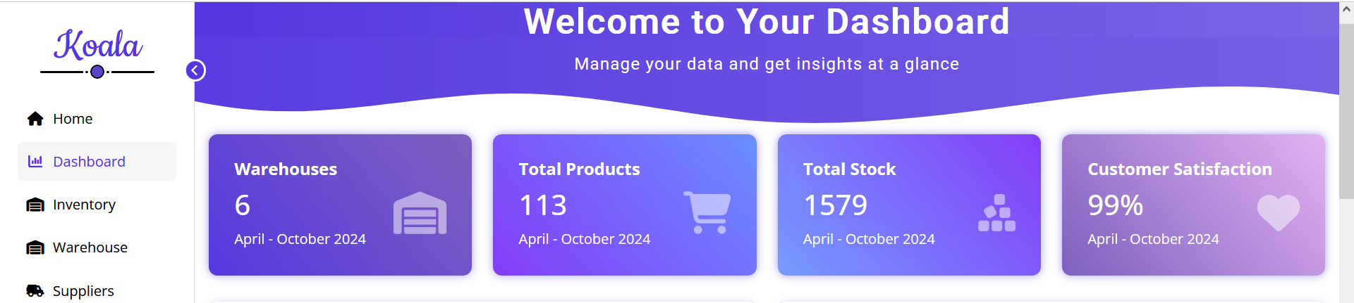
Inventory Statistics
Warehouse: Numbers of all warehouses in system
Total Products: Total numbers of products in warehouses
Total stock : Total stocks in all warehouse of all products

Slide 21
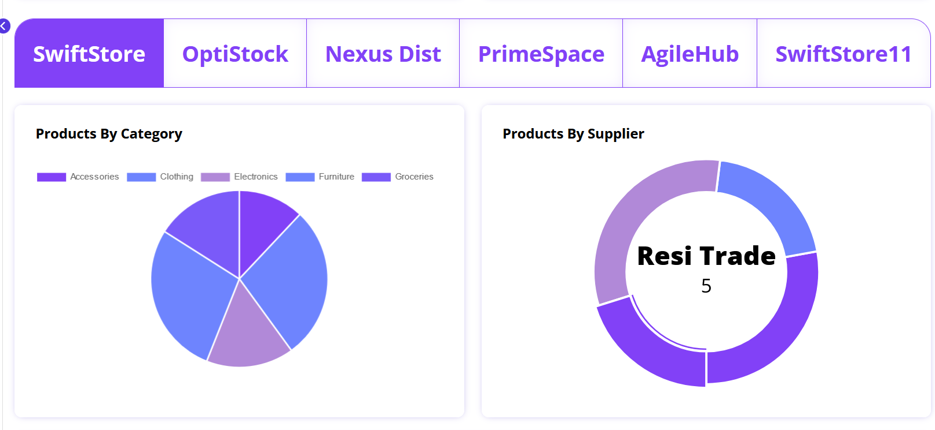
Each warehouse Statistics
Warehouses Taps
Products in each category in selected warehouse
Supplier of each category in selected warehouse

Slide 22
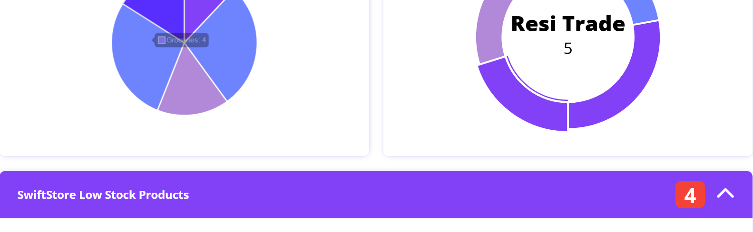
Low stock products
Table contain each product in selected warehouse which current stock is less than minimum stock required

Slide 23
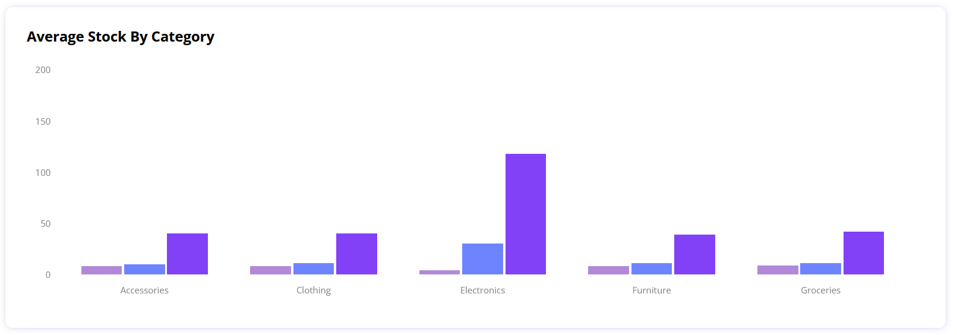
Average Stock by category
Average of products in each category

